Slide 1

GreenDot Onboarding

Slide 2
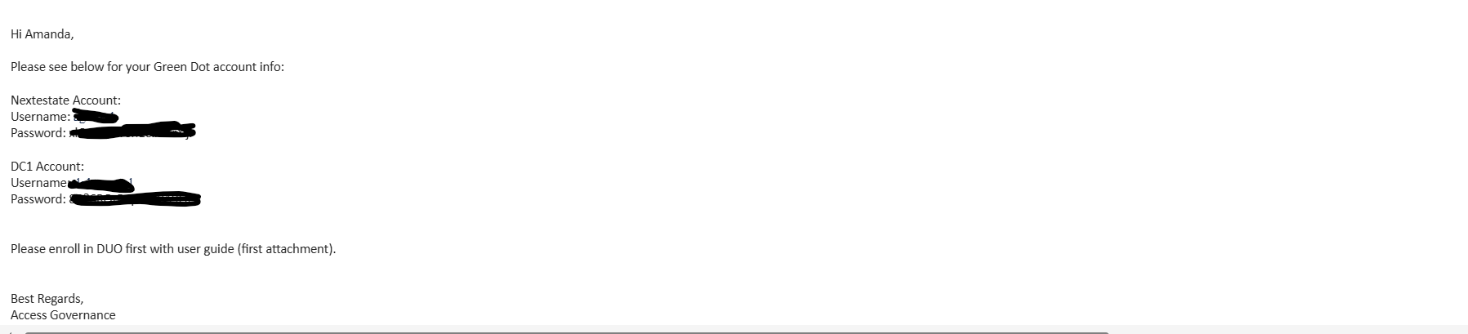
Email Communication
You will receive an email from “Green Dot Account Info GreenDotAccountInfo@greendotcorp.com” containing:
Your Nextestate username and password and DC1 username and password (refer below screenshot)
A PDF document with instructions for enrolling in DUO
As a first step, please install and set up the Duo Mobile app on your personal mobile device, following the instructions in the “Enrolling in DUO” PDF. Once Duo is set up, proceed to configure GD VDI as outlined starting from slide 3.

Slide 3
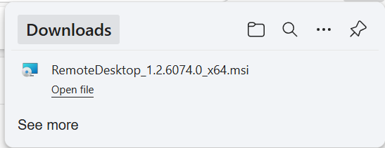
Download the Duo Mobile app on your mobile device
Refer to the attached PDF for steps for installing the Duo Mobile App (IOS and Android).
Install the Remote Desktop
Follow the below steps to download the Remote Desktop:
Step 1: Connect to Deloitte VPN before downloading Remote Desktop.
Step 2: Click on https://go.microsoft.com/fwlink/?linkid=2068602 and download Remote Desktop client.
Step 3: Open “RemoteDesktop_1.2.6074.0_x64” file.

Slide 4
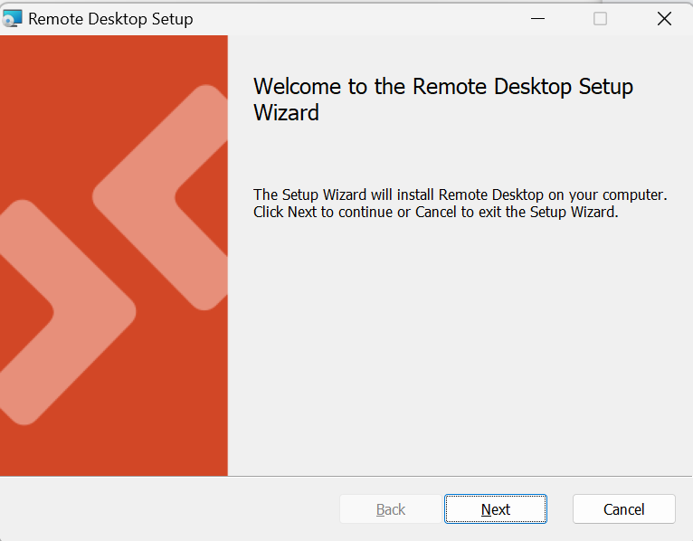
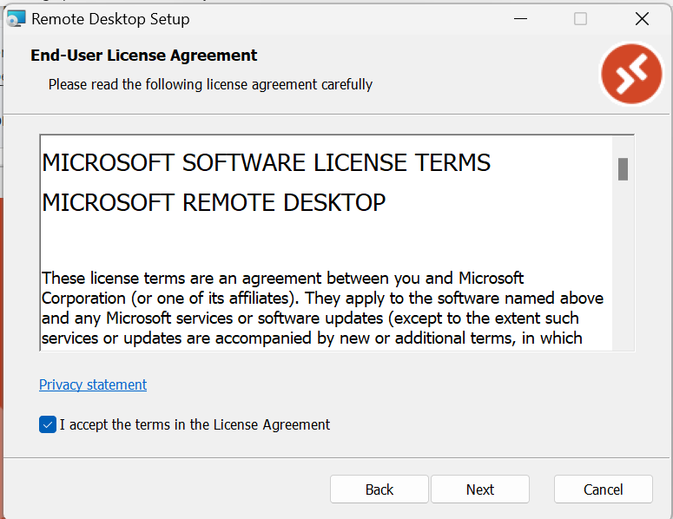
Step 4: After clicking on “RemoteDesktop_1.2.6074.0_x64” file, it will open a pop up to Remote Desktop set up.
Step 5: Click on “Next” and then click on “I accept the terms in the License Agreement”.

Slide 5
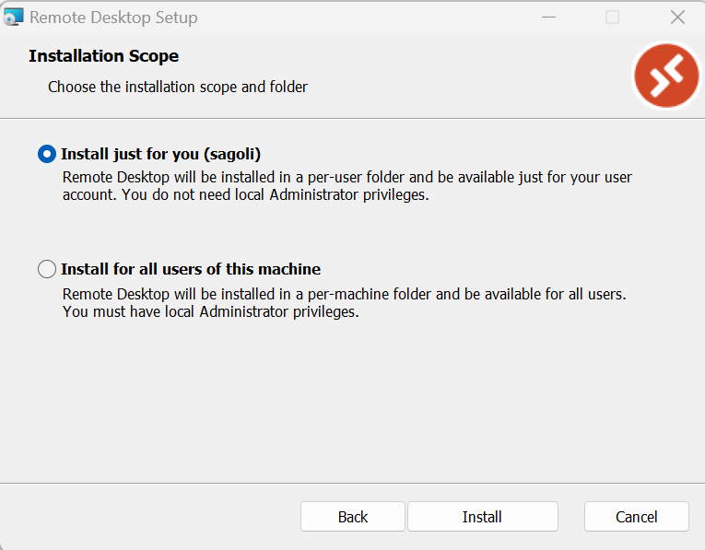
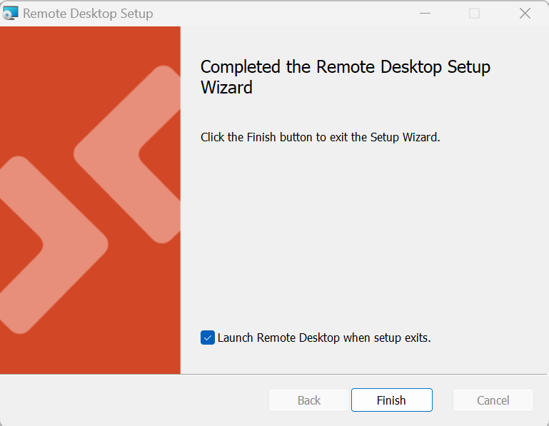
Step 6: Click on “Next” and check the radio button to “Install just for you (username)”.
Step 7: Click on “Finish” to Complete the Remote Desktop Setup Wizard.

Slide 6
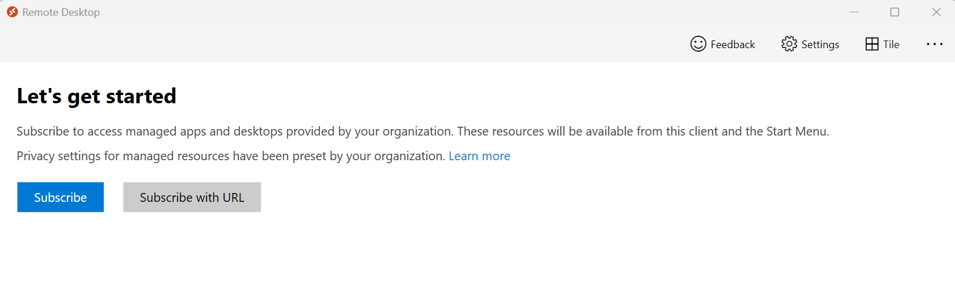
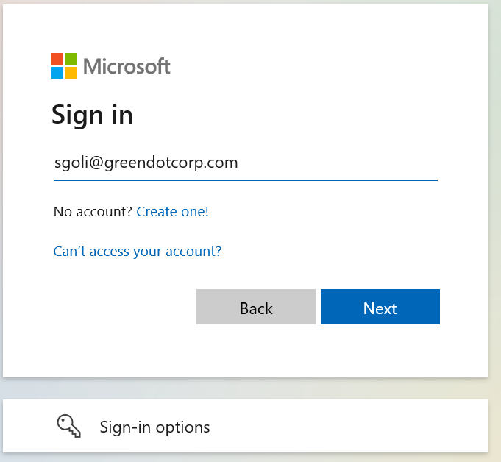
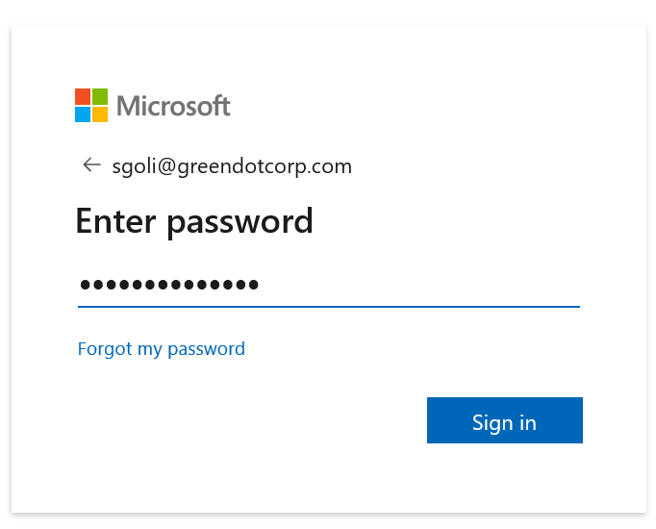
Step 8: Get on Deloitte VPN before you download Remote Desktop client. Once, the Remote Desktop is installed, click on “Subscribe” and log in while on VPN using your Nextestate username and password.
When you login to the Remote desktop, type in your nextestate username and add @greendotcorp.com and use your nextestate password.

Slide 7
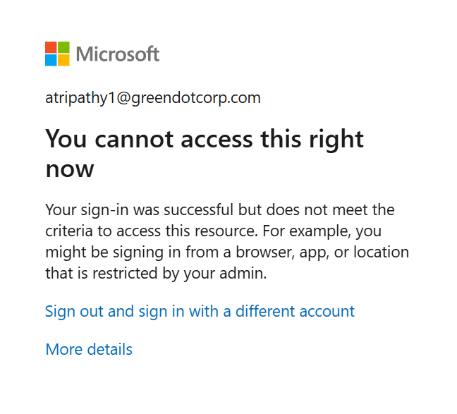
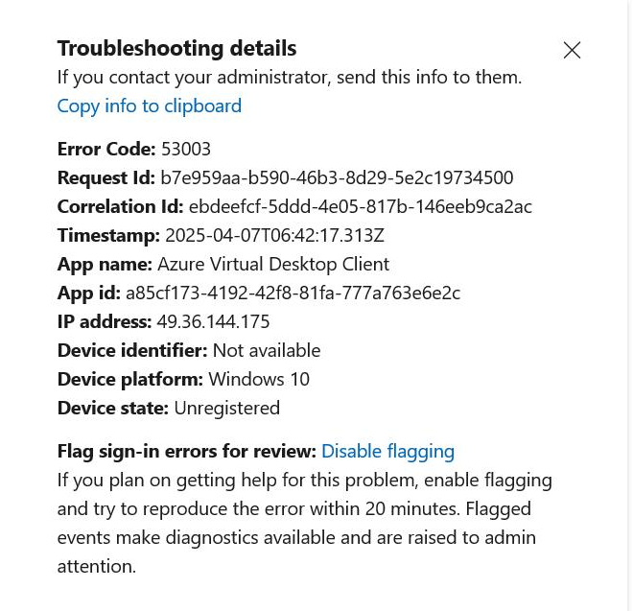
Note: In case, you are getting the below screen after entering your email address and password, please connect to Deloitte VPN, in case you haven’t already connected.

Slide 8
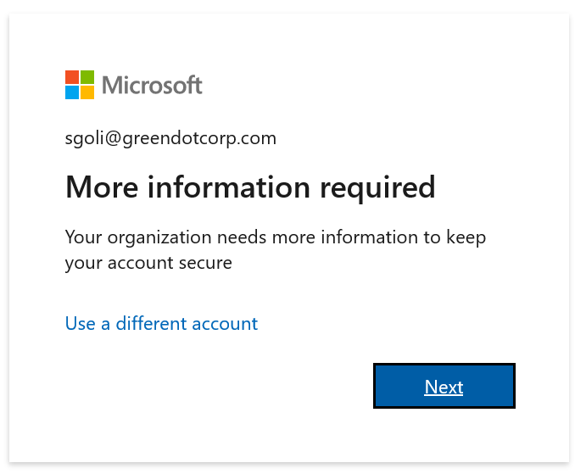
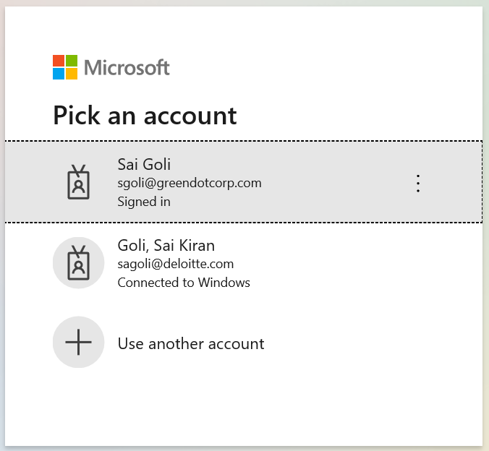
Step 9: In case, you are getting the below screen after entering your email address and password, click on “Next” and select your Green dot username shown below.

Slide 9
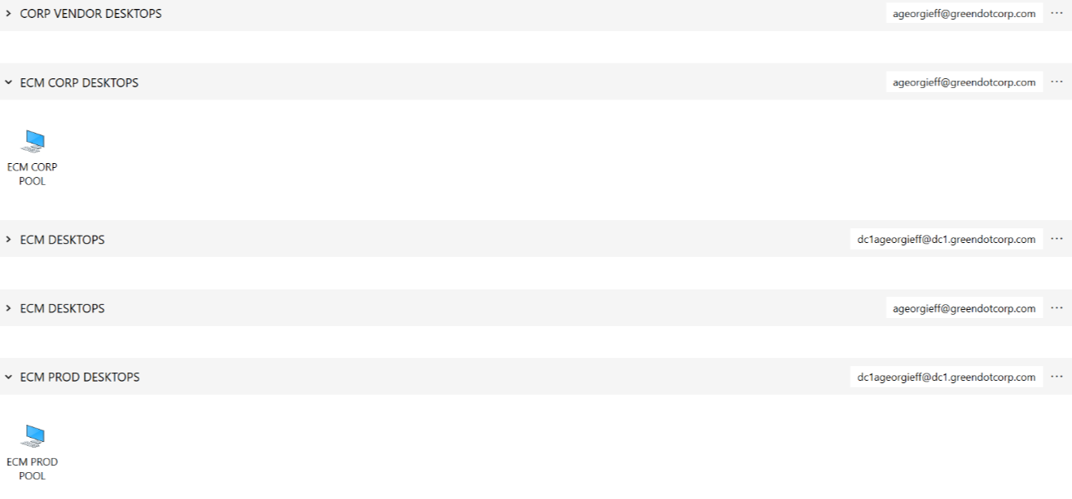
Step 10: After selecting your Green Dot username, you will get an option to log into ECM Corp Pool or the ECM Prod Pool desktop.
ECM Corp Pool – use Nextestate usernames/passwords (this desktop is used for internet research)
ECM Prod Pool – use DCI username/password (this desktop is used to access ECM)

Slide 10
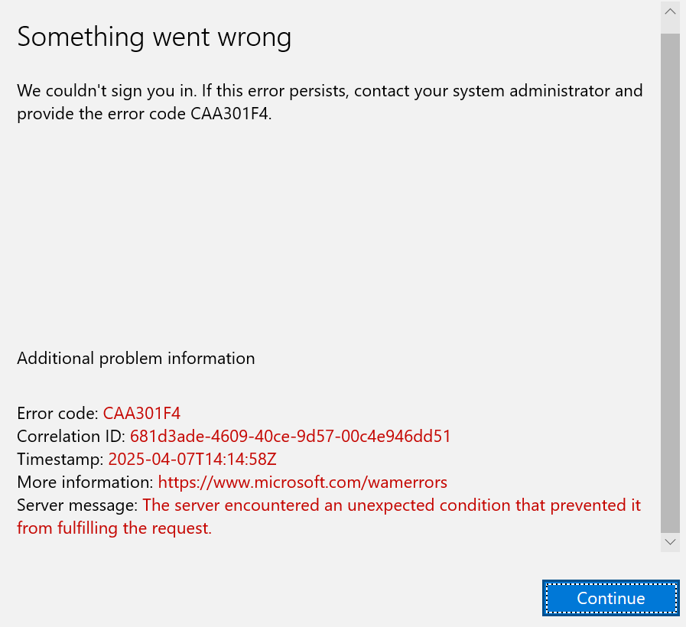
Note: In case, you are getting the below screen send an email to “Long Truong ltruong@greendotcorp.com” mentioning him regarding the issues accessing the remote desktop. Additionally, please provide him with your Green Dot email address and phone numbers, so that the Green dot team can reset your password.

Slide 11
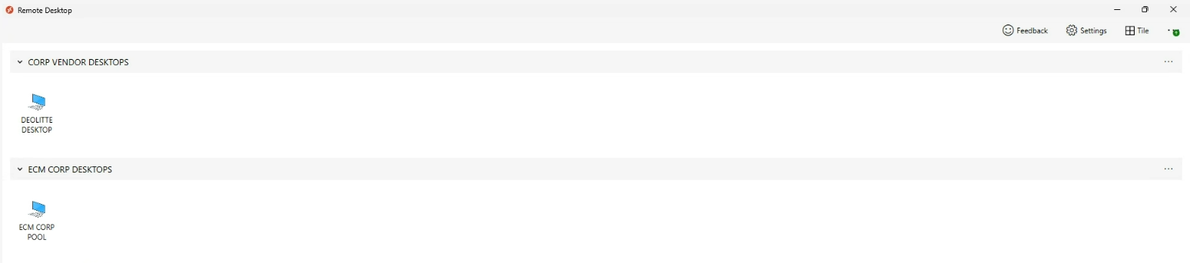
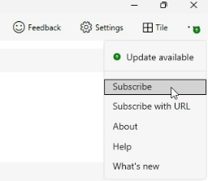
Accessing the ECM PROD Desktop
Navigate to Remote desktop
Click on the three dots in the top right hand bar, and click subscribe

Slide 12
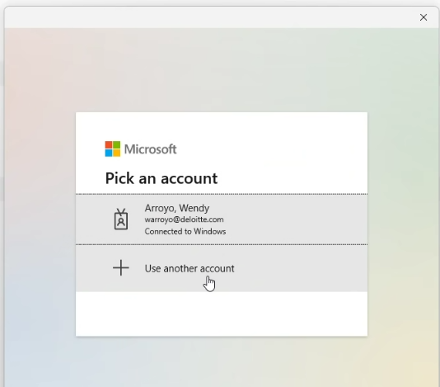
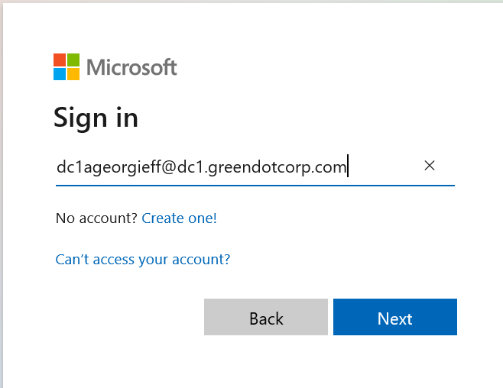
Accessing the ECM PROD Desktop
3. Click “Use Another Account”
4. Click “Use Another Account”
5. Add in your DC1 Username: dc1[username]@dc1.greendotcorp.com
6. Enter your DC1 password (temporary)

Slide 13
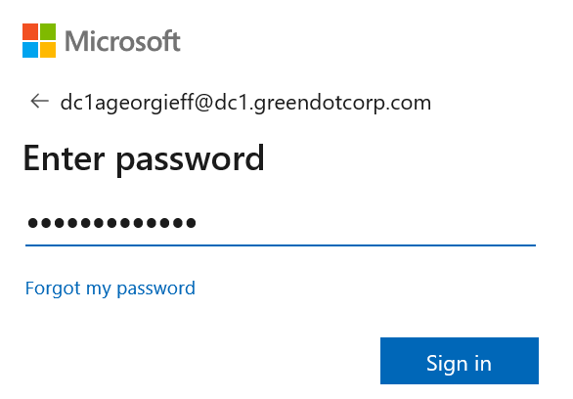
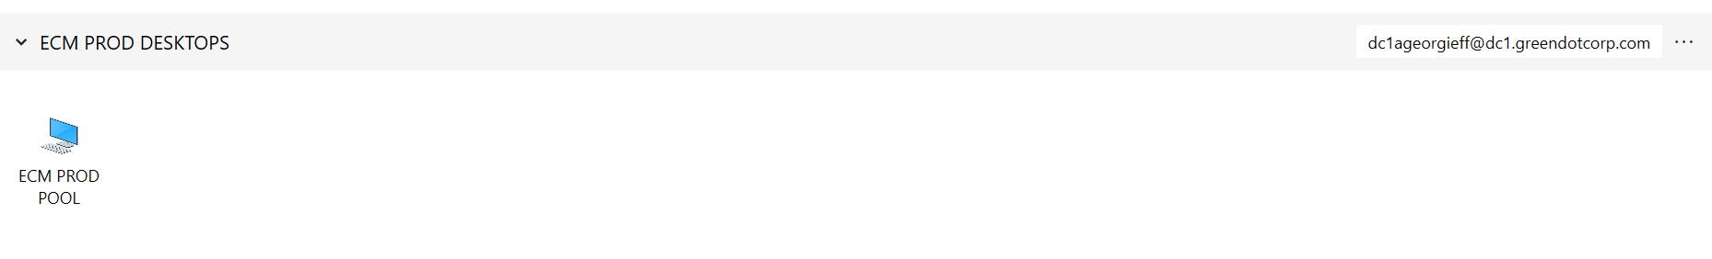
Accessing the ECM PROD Desktops
7. Enter your temporary password
8. You should now see ECM Prod Pool under ECM PROD Desktops (this will be the desktop you use to get access ECM)

Slide 14
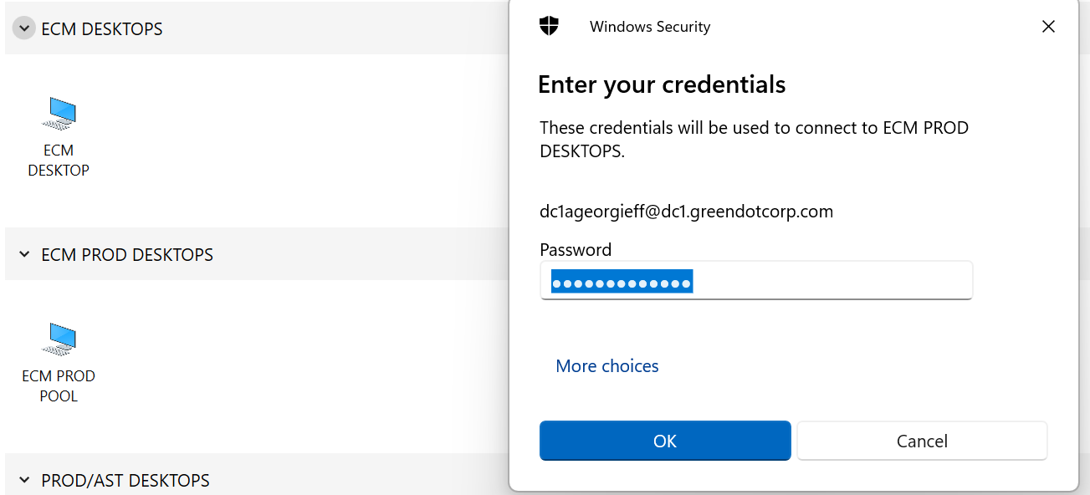
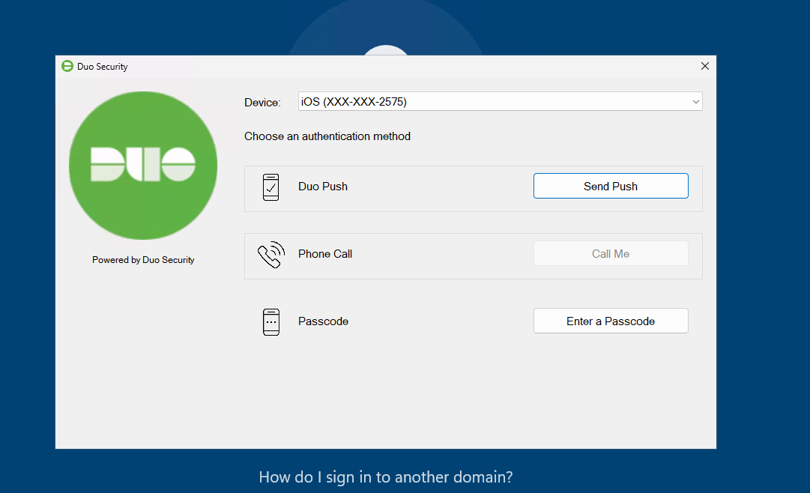
Accessing the ECM PROD Desktops
9. Double click on the icon ECM PROD POOL and enter your credentials (DC1 e-mail and password)
9. Click on “Send Push” and approve sign on

Slide 15
Accessing the ECM Corp Desktop
Navigate to Remote desktop
Click on the three dots in the top right hand bar, and click subscribe

Slide 16
Accessing the ECM Corp Desktop
3. Click “Use Another Account”
4. Click “Use Another Account”
5. Add in your Nextestate Username: [username]@greendotcorp.com
6. Enter your Nextestate password

Slide 17
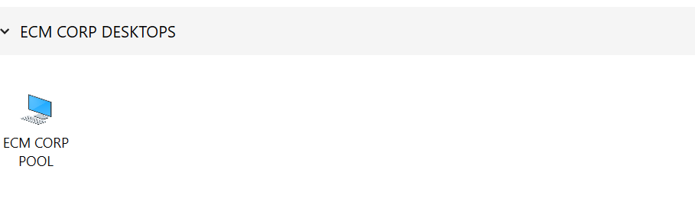
Accessing the ECM Corp Desktops
7. Enter your temporary password
8. You should now see ECM Corp Pool under ECM PROD Desktops (this will be the desktop you use to conduct internet research)

Slide 18
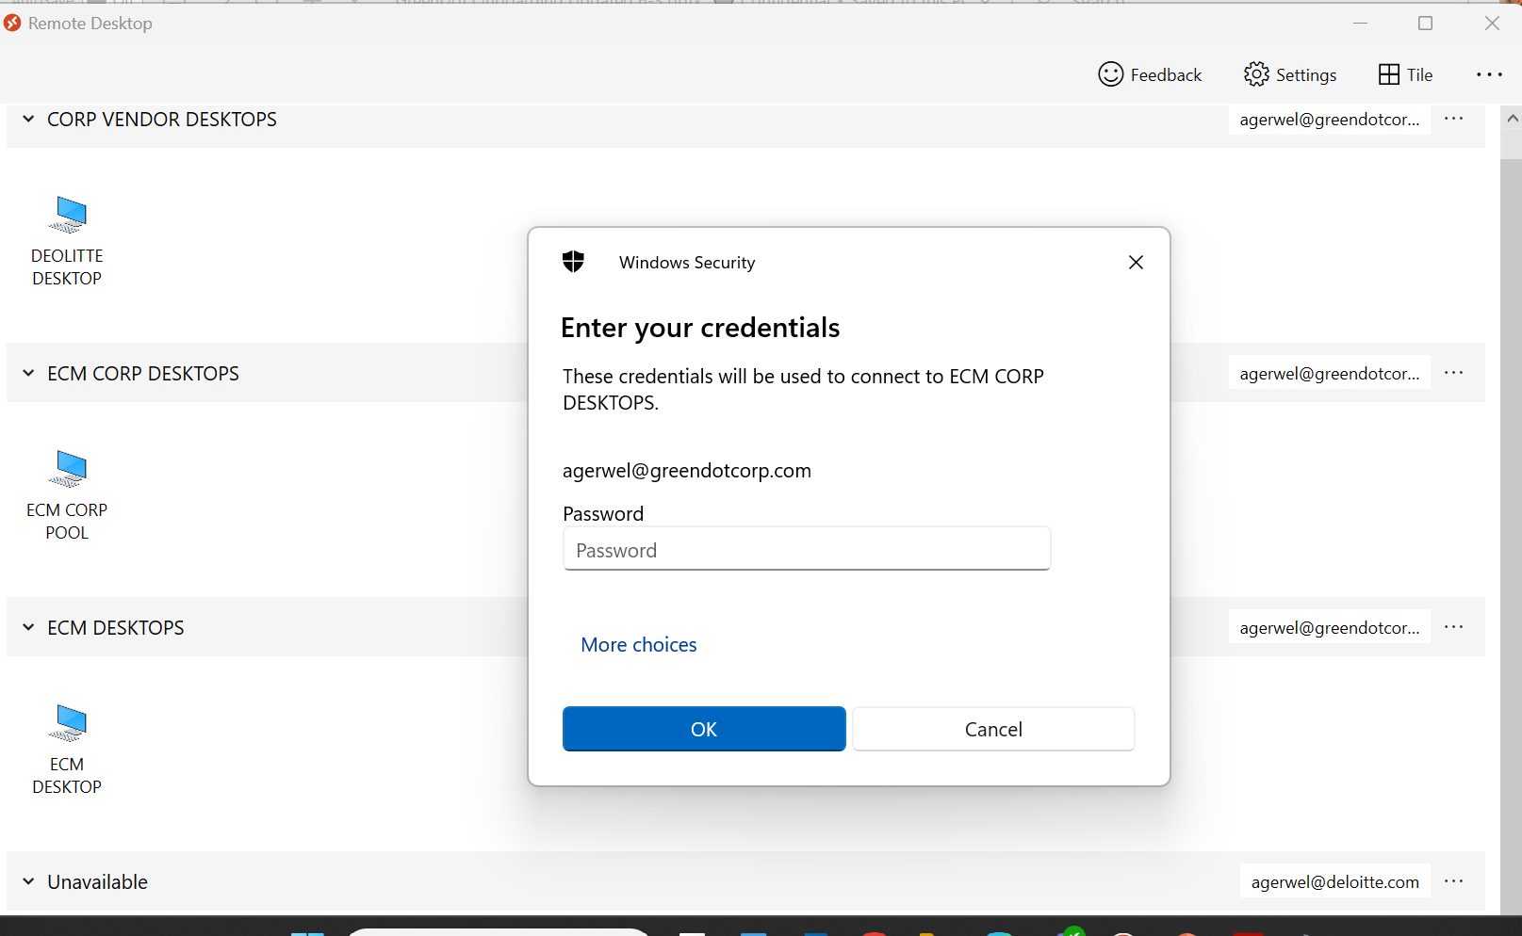
Accessing the ECM Corp Desktops
9. Double click on the icon ECM PROD POOL and enter your credentials (Nexestate e-mail and password)
9. Click on “Send Push” and approve sign on

Slide 19
Change Password (Post VDI Set-up)
Green Dot account password policy
90-days rotation
Contain both upper- & lower-case characters (e.g., a-z, A-Z)
Have digits & punctuation characters as well as letters
Minimum of 12 alphanumeric characters long
Are not based on personal information, names of family, etc.
Passwords should never be written down or stored by a web browser
How to update your green dot password:
Login into your Remote Desktop (Green Dot VDI).
Open Microsoft edge and go to http://microsoft365.com/?home=1
Click on Account Manager on the left-hand bottom panel and click on view account details
Once your account is open, click on “Password” appearing on the left-hand panel.
After which Cisco Duo will ask for two factor verification.
Once, the login is verified through the Cisco Duo application, a pop-up window will appear to set the New Password and reconfirm the New Password.

Slide 20
Links for Password Lockouts/Disabled Accounts
For a password reset lockout, use this link:
https://passwordreset.microsoftonline.com/
For a disabled account, use this link to re-enable account:
https://greendot.atlassian.net/servicedesk/customer/portal/107/group/151/create/475

Slide 21

Thank you
Anuloma Tripathy
antripathy@deloitte.com
atripathy1@greendotcorp.com
Sai Goli Kiran
sagoli@deloitte.com
sgoli@greendotcorp.com

